Slide 1
Testing of Hypothesis

Slide 2
Tests for population means
Sample deviation(σ) known : One-sample Z-test

Slide 3
Assumptions of Z-test

Slide 4
Tests for population means
Sample deviation(σ) known : One-sample Z-test
Population size(N): infinite or unknown

Slide 5
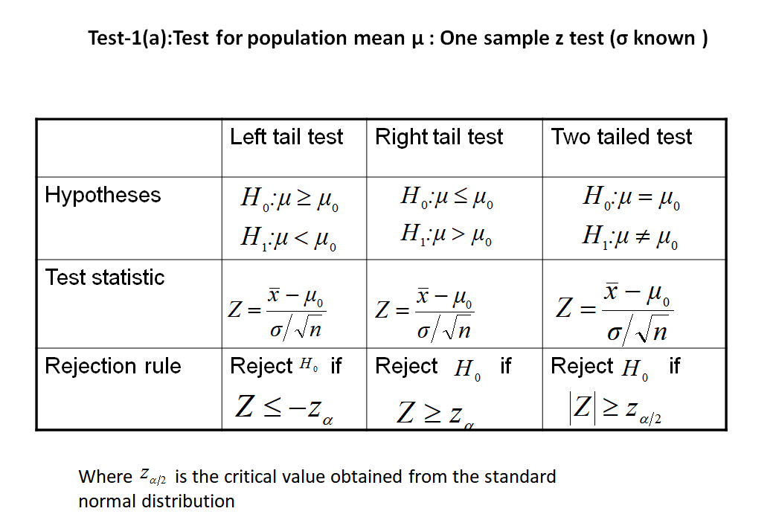

Slide 6
Tests for population means
Sample deviation(σ) known : One-sample Z-test
Population size(N): infinite or unknown
Population size(N): finite and known

Slide 7
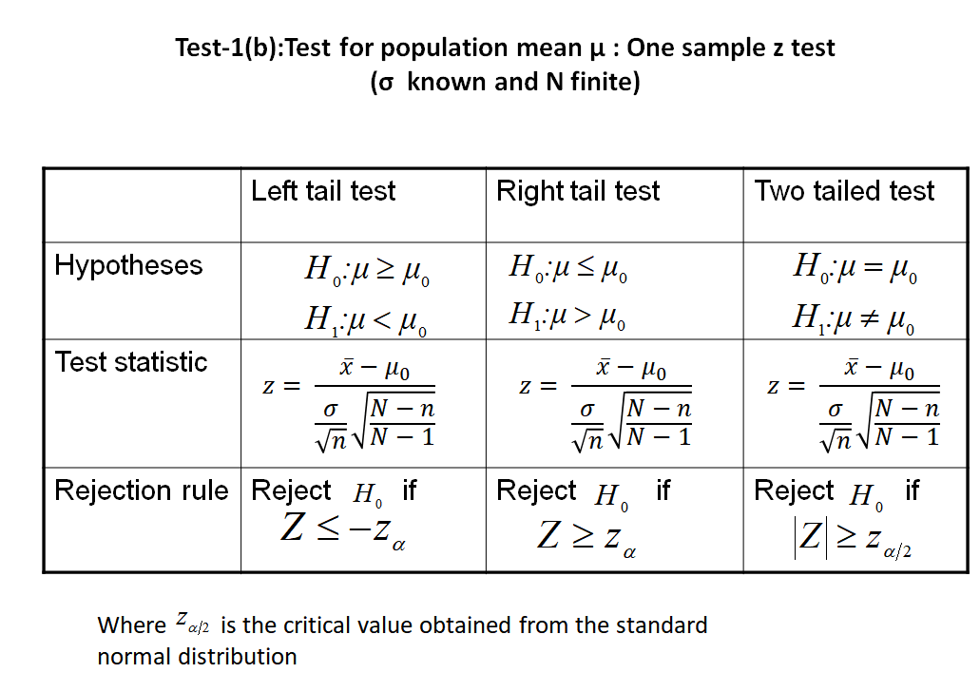

Slide 8
Tests for population means
Sample deviation(σ) known : One-sample Z-test
Population size(N): infinite or unknown
Population size(N): finite and known
Sample deviation(σ) unknown: One sample t-test

Slide 9
Assumptions of One-sample t-test:
Population is normally distributed
SD is not known

Slide 10
Characteristics of t distribution
t statistic for estimating a population mean is relatively robust to the assumption that the population is normally distributed.
Like the standard normal curve, t distributions are symmetric, unimodal and a family of curves.
To find a value in the t distribution, requires knowing the degrees of freedom; each different value of degrees of freedom is associated with a different t distribution.
The term degrees of freedom(d.f.) refers to number of independent observations for a source of variation minus the number of independent parameters estimated in computing the variation.

Slide 11
Tests for population means
Sample deviation(σ) known : One-sample Z-test
Population size(N): infinite or unknown
Population size(N): finite and known
Sample deviation(σ) unknown: One sample t-test
Population size(N): infinite or unknown

Slide 12
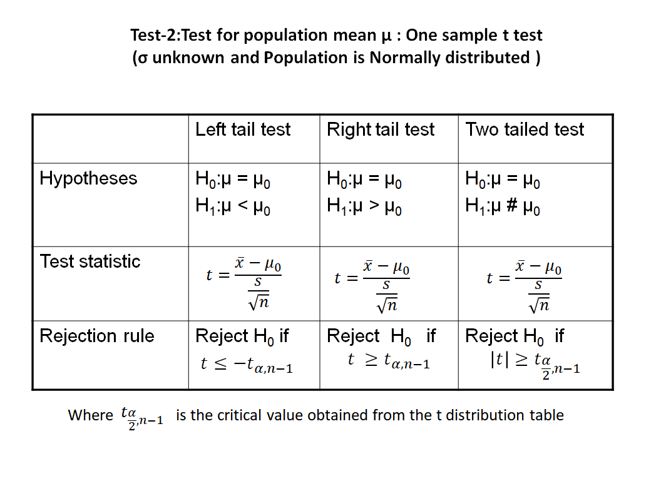

Slide 13
Tests for population means
Sample deviation(σ) known : One-sample Z-test
Population size(N): infinite or unknown
Population size(N): finite and known
Sample deviation(σ) unknown: One sample t-test
Population size(N): infinite or unknown
Population size(N): finite and known

